Slide 1
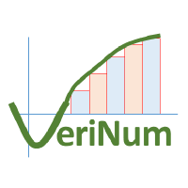

Parallel Dot Product
https://github.com/VeriNum/pardotprod
Andrew W. Appel
Princeton
University
August 2022

Slide 2
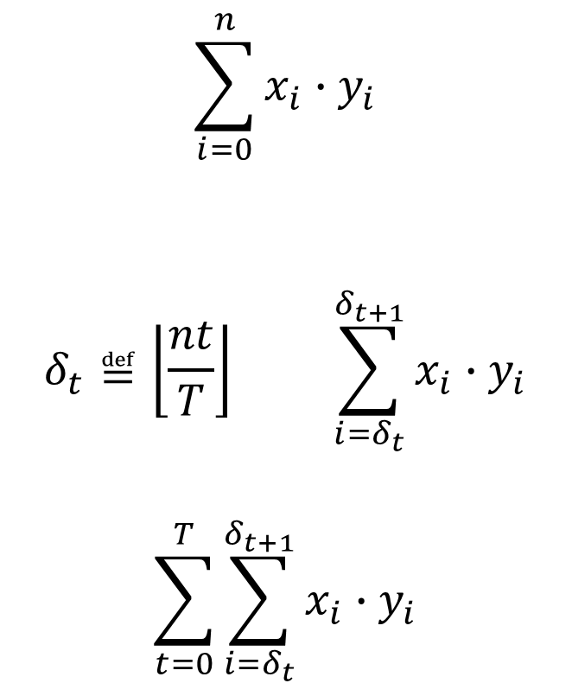
Simple Task Parallelism
All ranges are [lo,hi)
Have a function to compute on big data
Have T processors
Divide computation into T subfunctions (compute in parallel)
Combine subresults together
$$\sum_{i=0}^{n}{x_{i}{∙y}_{i}}$$
$$δ_{t}≝\left\lfloor \frac{nt}{T}\right\rfloor \sum_{i=δ_{t}}^{δ_{t+1}}{x_{i}{∙y}_{i}}$$
$$\sum_{t=0}^{T}{\sum_{i=δ_{t}}^{δ_{t+1}}{x_{i}{∙y}_{i}}}$$

Slide 3
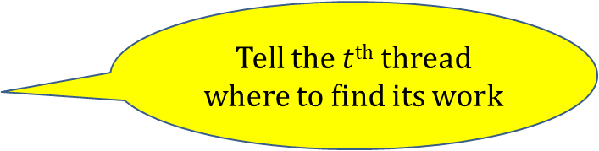
API for work-splitting
parsplit.h
Start T-1 threads
(plus parent makes T)
struct task *make_tasks (unsigned T);
void initialize_task (struct task *tasks,
unsigned t,
void (*f)(void *),
void *closure);
void do_tasks (struct task *tasks, unsigned T);
Tell the $t$^{th} thread where to find its work
Run all the threads on their work
(can do this again and again)

Slide 4











Example: n=10, T=4
struct task *make_tasks (unsigned T);
void initialize_task (struct task *tasks, unsigned t, void (*f)(void *), void *closure);
void do_tasks (struct task *tasks, unsigned T);
$$δ_{0}$$
$$x$$
$$y$$
$$δ_{t}≝nt/T$$
$$n_{t}≝δ_{t+1}−δ_{t}$$
0
$$δ_{1}$$
one slice
of work
$$δ_{2}$$
$$δ_{3}$$
$$x+δ_{t}$$
$$y+δ_{t}$$
$$n_{t}$$
result
$$δ_{4}$$
10
Task description

Slide 5

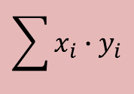



Application-specific subtask function
struct task *make_tasks (unsigned T);
void initialize_task (struct task *tasks, unsigned t, void (*f)(void *), void *closure);
void do_tasks (struct task *tasks, unsigned T);
$$x$$
$$y$$
void dotprod_worker(void *closure) {
struct dotprod_task *w = closure;
double result=0.0;
unsigned n = w->n;
double *vec1= w->vec1, *vec2= w->vec2;
unsigned i;
for (i=0; i<n; i++)
result += vec1[i]*vec2[i];
w->result=result;
}
$$\sum{x_{i}{∙y}_{i}}$$
$$x+δ_{t}$$
$$y+δ_{t}$$
$$n_{t}$$
result

Slide 6










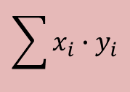


make_tasks( ), initialize_task( )
struct task *make_tasks (unsigned T);
void initialize_task (struct task *tasks, unsigned t, void (*f)(void *), void *closure);
void do_tasks (struct task *tasks, unsigned T);
$$\sum{x_{i}{∙y}_{i}}$$
dtasks
$$x$$
$$y$$
$$x+δ_{0}$$
$$y+δ_{0}$$
$$n_{0}$$
result
$$x+δ_{1}$$
$$y+δ_{1}$$
$$n_{1}$$
result
$$x+δ_{2}$$
$$y+δ_{2}$$
$$n_{2}$$
result
$$x+δ_{3}$$
$$y+δ_{3}$$
void make_dotprod_tasks(unsigned T) {
unsigned t;
tasks = make_tasks(T);
num_threads=T;
dtasks=(struct dotprod_task *)malloc(T*sizeof(…));
for (t=0; t<T; t++)
initialize_task(tasks, t, dotprod_worker, dtasks+t);
}
$$n_{3}$$
result

Slide 7
do_tasks( )
struct task *make_tasks (unsigned T);
void initialize_task (struct task *tasks, unsigned t, void (*f)(void *), void *closure);
void do_tasks (struct task *tasks, unsigned T);
$$\sum{x_{i}{∙y}_{i}}$$
dtasks
$$x$$
$$y$$
$$x+δ_{0}$$
$$y+δ_{0}$$
$$n_{0}$$
result
$$x+δ_{1}$$
$$y+δ_{1}$$
$$n_{1}$$
result
$$x+δ_{2}$$
$$y+δ_{2}$$
double dotprod(double *vec1, double *vec2, unsigned n) {
for (delta=0, t=0; t<T; t++) {
dtasks[t].vec1=vec1+delta;
dtasks[t].vec2=vec2+delta;
delta_next = (t+1)*n/T;
dtasks[t].n= delta_next-delta;
delta=delta_next;
}
do_tasks(tasks, T);
for (result=0.0, t=0; t<T; t++) result += dtasks[t].result;
return result;
}
$$n_{2}$$
result
$$x+δ_{3}$$
$$y+δ_{3}$$
$$n_{3}$$
result

Slide 8
That’s the entire dotprod.c client
void dotprod_worker(void *closure) {
struct dotprod_task *w = closure;
double result=0.0;
unsigned n = w->n;
double *vec1= w->vec1, *vec2= w->vec2;
unsigned i;
for (i=0; i<n; i++)
result += vec1[i]*vec2[i];
w->result=result;
}
double dotprod(double *vec1, double *vec2, unsigned n) {
for (delta=0, t=0; t<T; t++) {
dtasks[t].vec1=vec1+delta;
dtasks[t].vec2=vec2+delta;
delta_next = (t+1)*n/T;
dtasks[t].n= delta_next-delta;
delta=delta_next;
}
do_tasks(tasks, T);
for (result=0.0, t=0; t<T; t++) result += dtasks[t].result;
return result;
}
void make_dotprod_tasks(unsigned T) {
unsigned t;
tasks = make_tasks(T);
num_threads=T;
dtasks=(struct dotprod_task *)malloc(T*sizeof(…));
for (t=0; t<T; t++)
initialize_task(tasks, t, dotprod_worker, dtasks+t);
}
struct task *make_tasks (unsigned T);
void initialize_task (struct task *tasks, unsigned t, void (*f)(void *), void *closure);
void do_tasks (struct task *tasks, unsigned T);
How is the parallelism implemented?

Slide 9
thread_worker( ), make_tasks( )
struct task *make_tasks (unsigned T);
void initialize_task (struct task *tasks, unsigned t, void (*f)(void *), void *closure);
void do_tasks (struct task *tasks, unsigned T);
tasks
struct task *make_tasks(unsigned T) {
tasks = malloc(T * sizeof (…));
for (i=1; i<T; i++) {
struct task *t = tasks+i;
t->go = makelock();
t->done = makelock();
spawn(thread_worker, t);
}
return tasks;
}
go
f
done
closure
int thread_worker(void *arg) {
struct task *t = (struct task *)arg;
while (1) {
acquire(t->go);
t->f(t->closure);
release(t->done);
}
}

Slide 10
initialize_task ( )
struct task *make_tasks (unsigned T);
void initialize_task (struct task *tasks, unsigned t, void (*f)(void *), void *closure);
void do_tasks (struct task *tasks, unsigned T);
tasks
go
f
done
closure
void initialize_task (struct task *tasks,
unsigned i,
void (*f)(void *),
void *closure) {
tasks[i].f=f;
tasks[i].closure=closure;
}

Slide 11
do_tasks ( )
struct task *make_tasks (unsigned T);
void initialize_task (struct task *tasks, unsigned t, void (*f)(void *), void *closure);
void do_tasks (struct task *tasks, unsigned T);
tasks
go
f
done
closure
void do_tasks(struct task *tasks, unsigned T) {
for (i=1; i<T; i++)
release (tasks[i].go);
tasks[0].f(tasks[0].closure);
for (i=1; i<T; i++)
acquire (tasks[i].done);
}

Slide 12
That’s the entire parsplit.c
struct task *make_tasks (unsigned T);
void initialize_task (struct task *tasks, unsigned t, void (*f)(void *), void *closure);
void do_tasks (struct task *tasks, unsigned T);
int thread_worker(void *arg) {
struct task *t = (struct task *)arg;
while (1) {
acquire(t->go);
t->f(t->closure);
release(t->done);
}
}
void initialize_task (struct task *tasks,
unsigned i, void (*f)(void *), void *closure) {
tasks[i].f=f;
tasks[i].closure=closure;
}
struct task *make_tasks(unsigned T) {
tasks = malloc(T * sizeof (…));
for (i=1; i<T; i++) {
struct task *t = tasks+i;
t->go = makelock();
t->done = makelock();
spawn(thread_worker, t);
}
return tasks;
}
void do_tasks(struct task *tasks, unsigned T) {
for (i=1; i<T; i++)
release (tasks[i].go);
tasks[0].f(tasks[0].closure);
for (i=1; i<T; i++)
acquire (tasks[i].done);
}

Slide 13
How to prove it

Slide 14
Separation Logic
If state
satisfies the
precondition
then it’s safe
to run the
command
and the state
after will satisfy
the postcondition
{Pre} command {Post}
separating
conjunction
P∗Q
P′∗Q
{ x↦(1,y) ∗ y↦(2,z) }
x.data=3;
{ x↦(3,y) ∗ y↦(2,z) }
x
1
2
z
x
3
2
z
y
y

Slide 15
Heaplets in Separation Logic
x↦(1,y) ∗ y↦(2,z)
1
2
z
x
y
x↦(1,y) ∗ y↦(2,z)
1
2
z
x
y

Slide 16
Heaplets in Separation Logic
1
2
z
x
y
{ x↦(1,y) ∗ y↦(2,z) }
x.data=3;
{ x↦(3,y) ∗ y↦(2,z) }
3
2
z
x
y

Slide 17
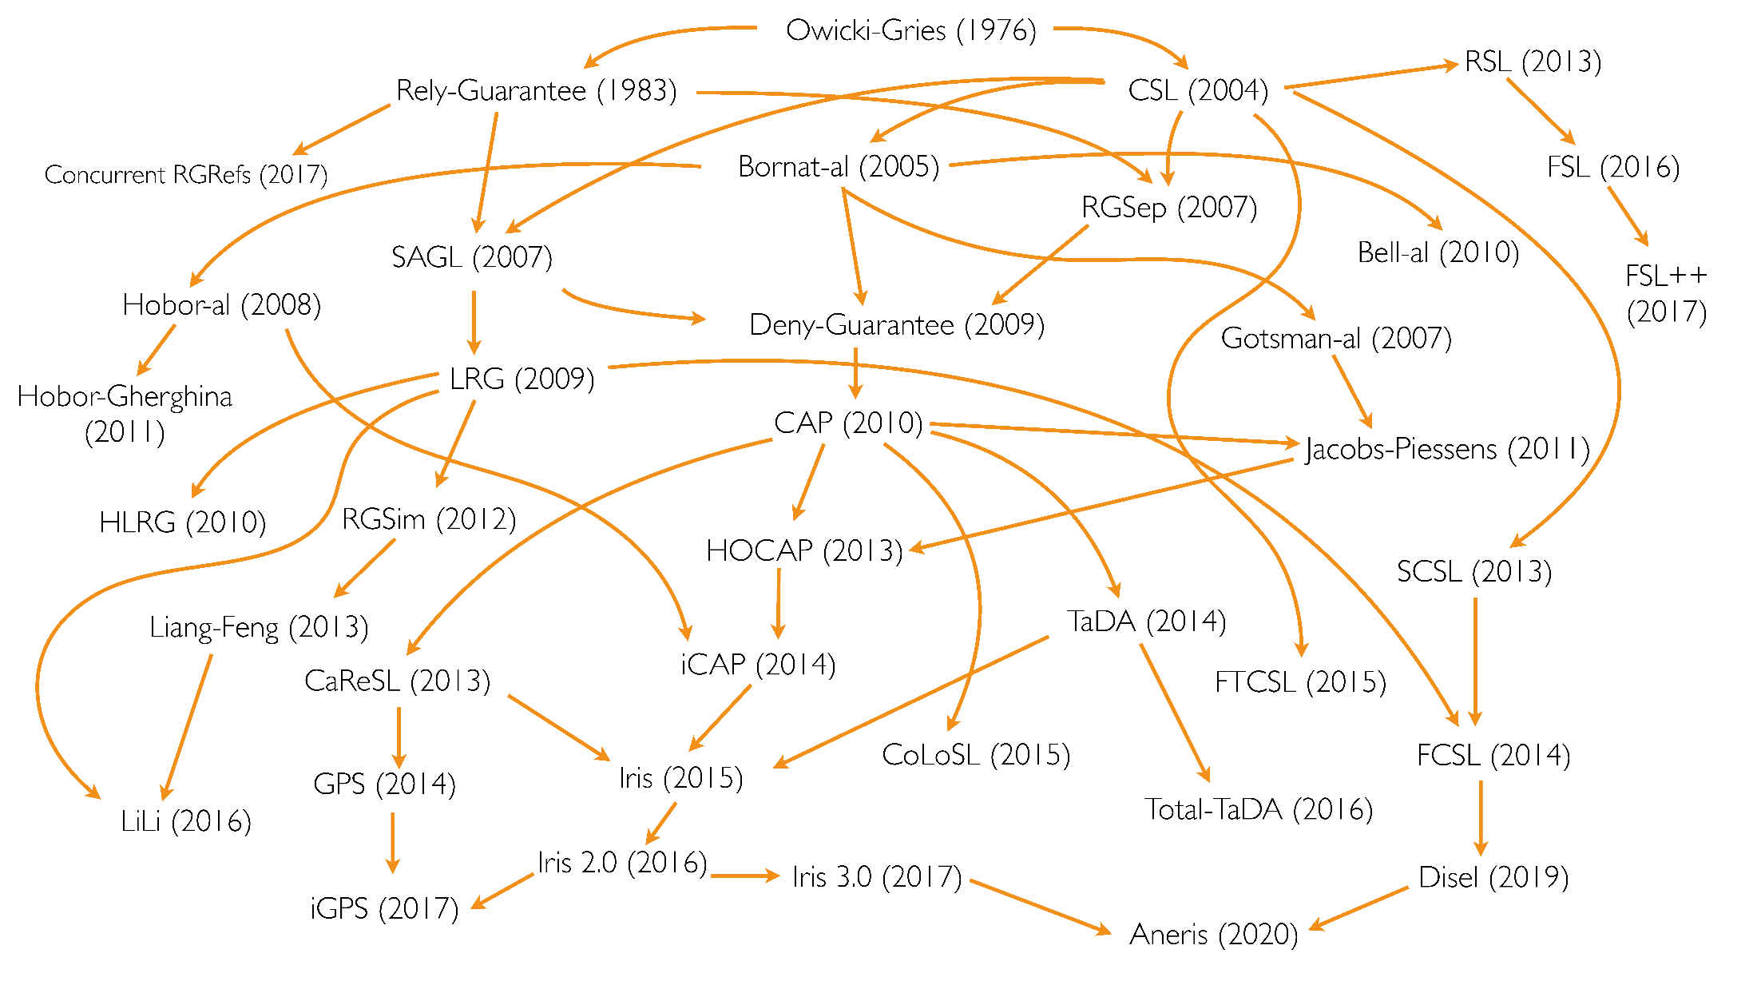
Concurrent Separation Logics
diagram: Ilya Sergey

Slide 18
How to prove it
Should be simple:
Don’t need ghost state
Don’t need partial commutative monoid
Semaphores with “old-fashioned” lock invariants
Permission-splitting
∴ all the theory was in place by 2008!

Slide 19
Concurrent Separation Logics
diagram: Ilya Sergey

Slide 20
Concurrent Separation Logics
What does VST support, by the way?
Shengyi Wang and
William Mansky 2022
diagram: Ilya Sergey

Slide 21
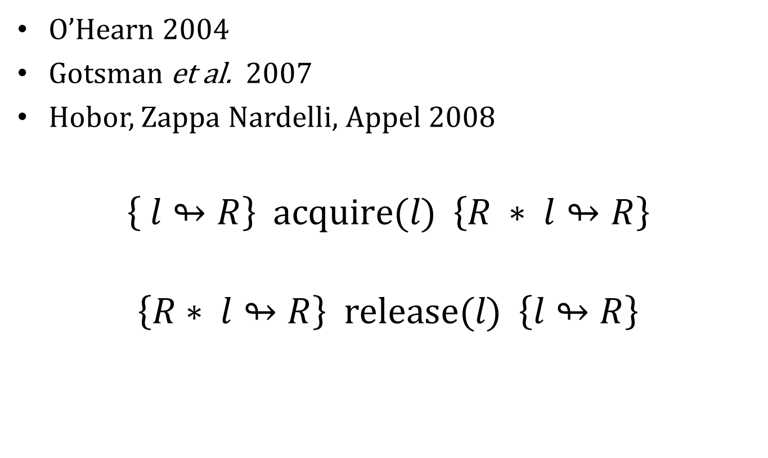
Resource invariants
O’Hearn 2004
Gotsman et al. 2007
Hobor, Zappa Nardelli, Appel 2008
$$\left\{ l↬R\right\} \text{acquire}\text{(}l\text{) } \left\{R ∗ l↬R\right\}$$
$$\left\{R∗ l↬R\right\} \text{release}\text{(}l\text{) } \left\{l↬R\right\}$$

Slide 22
Heaplets in Separation Logic
1
2
z
x
y
{ x↦(1,y) ∗ y↦(2,z) ∗ 𝑙↬(∃y. x↦(1,y))}
release(𝑙)
{ y↦(2,z) ∗ 𝑙↬(∃y. x↦(1,y))}
1
2
z
x
y

Slide 23
Heaplets in Separation Logic
{𝑙↬(∃y. x↦(1,y))}
acquire(𝑙)
{ x↦(1,y) ∗ 𝑙↬(∃y. x↦(1,y))}
1
y
x

Slide 24
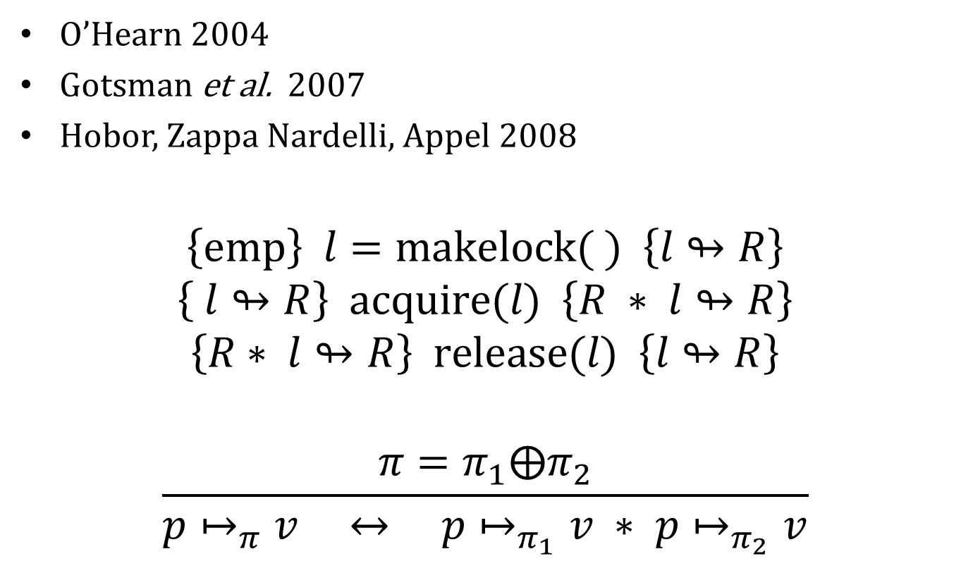
Resource invariants
O’Hearn 2004
Gotsman et al. 2007
Hobor, Zappa Nardelli, Appel 2008
$$\left\{\text{emp}\right\} l=\text{makelock}\text{(} \text{) } \left\{l↬R\right\}$$
$$\left\{ l↬R\right\} \text{acquire}\text{(}l\text{) } \left\{R ∗ l↬R\right\}$$
$$\left\{R∗ l↬R\right\} \text{release}\text{(}l\text{) } \left\{l↬R\right\}$$
$$\frac{π=π_{1}⨁π_{2}}{p↦_{π}v ↔ p↦_{π_{1}}v ∗ p↦_{π_{2}}v}$$

Slide 25
Resource invariants for parsplit
void do_tasks(struct task *tasks, unsigned T) {
for (i=1; i<T; i++)
release (tasks[i].go);
tasks[0].f(tasks[0].closure);
for (i=1; i<T; i++)
acquire (tasks[i].done);
}
int thread_worker(void *arg) {
struct task *t = (struct task *)arg;
while (1) {
acquire(t->go);
t->f(t->closure);
release(t->done);
}
}

Slide 26
Resource invariants for parsplit
void do_tasks(struct task *tasks, unsigned T) {
for (i=1; i<T; i++)
release (tasks[i].go);
tasks[0].f(tasks[0].closure);
for (i=1; i<T; i++)
acquire (tasks[i].done);
}
int thread_worker(void *arg) {
struct task *t = (struct task *)arg;
while (1) {
acquire(t->go);
t->f(t->closure);
release(t->done);
}
}
x
y
n
result
Definition task_inv $T q p$≔ $∃f∃clo, (p.\text{f} ↦_{\text{r}}f)∗(p.\text{closure}↦_{\text{r}}clo)∗∃c, P(T,c,q,clo).$

Slide 27



Questions and answers
$$P(T,c,q,clo).$$
$q$=ASK
x
y
n
$q$=ANSWER
x
y
n
x⋅y
Definition task_inv $T q p$≔ $∃f∃clo, (p.\text{f} ↦_{\text{r}}f)∗(p.\text{closure}↦_{\text{r}}clo)∗∃c, P(T,c,q,clo).$

Slide 28
Resource invariants
do_tasks
for (i=1; i<T; i++)
release (tasks[i].go);
for (i=1; i<T; i++)
acquire (tasks[i].done);
}
thread_worker
while (1) {
acquire(t->go);
t->f(t->closure);
release(t->done);
}
ASK
x
y
release(go)
acquire(go)
n
ANSWER
x
y
acquire(done)
release(done)
n
x⋅y

Slide 29


What question did I ask?
Client
Server
ASK
x
y
n
ANSWER
x
y
n
x⋅y
Client
Server
ASK
x
y
n
ANSWER
x7
y7
n
x7y7

Slide 30

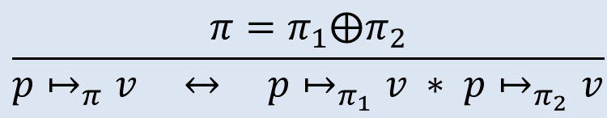


Splitting shares
$$\frac{π=π_{1}⨁π_{2}}{p↦_{π}v ↔ p↦_{π_{1}}v ∗ p↦_{π_{2}}v}$$
Client
Server
x
y
=
x
y
∗
x
y
n
$$⊤$$
n
$$π_{1}$$
n
$$π_{2}$$
read/write
read/write
read-only

Slide 31




Splitting shares
$$\frac{π=π_{1}⨁π_{2}}{p↦_{π}v ↔ p↦_{π_{1}}v ∗ p↦_{π_{2}}v}$$
Client
Server
x
y
=
x
y
∗
x
y
n
$$⊤$$
n
n
REMEMBER
ASK
x
y
ASK
n
$$π_{2}$$
x
y
ANSWER
n
x⋅y
$$π_{2}$$
x
y
∗
x’
y’
⊢ x=x’ ∧ y=y’
n
$$π_{1}$$
n
x’⋅y’
$$π_{2}$$

Slide 32

Must also split shares of . . .
x
y
ASK
n
$$π_{2}$$

Slide 33


The functional model
Floating-point add is not associative, so cannot prove
$$\sum_{i=0}^{n}{x_{i}{∙y}_{i}}$$
Instead we prove
$$\sum_{t=0}^{T}{\sum_{i=δ_{t}}^{δ_{t+1}}{x_{i}{∙y}_{i}}}$$
and let the upper-layer proofs worry about accuracy of associativity

Slide 34
Q.E.D.
That’s my proof!
In Coq it’s a bit more verbose.

Slide 35
But does the program work?
$ time ./dotprod 1000000 4 10000
N=1000000 T=4 R=10000
real 10.415s
user 40.703s
sys 0.140s
speedup 3.9 with 4 processors

Slide 36
Lines of program and proof
 | C lines | Coq lines | Ratio
dotprod client | 58 | 799 | 14:1
API | 10 | 148 | 15:1
parallelizer | 51 | 493 | 10:1
Ugh!
Too much.

